Slide 1
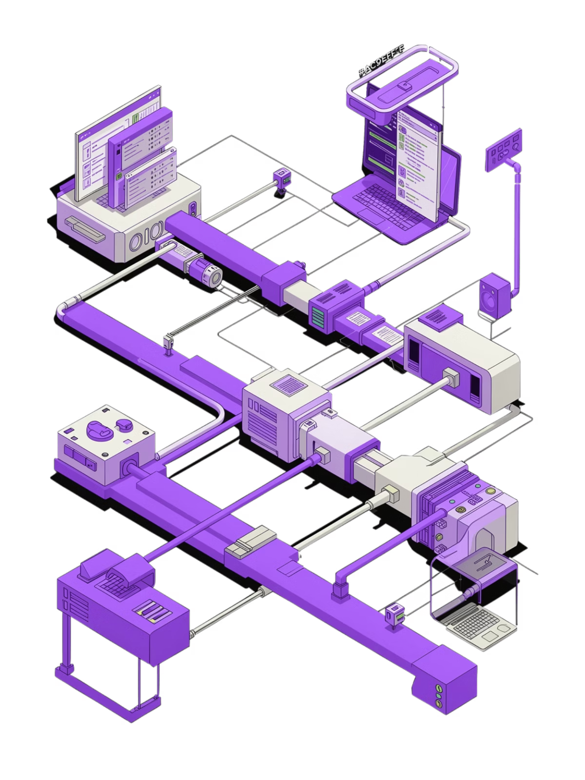
CHILD MAINTENANCE SERVICE — DIGITAL CHANNEL
JULY 2026
CMS Test Automation & CI/CD Integration
Shift-Left Quality Engineering | Automated Regression | Continuous Feedback
80% Faster
Zero Manual
Continuous
Test Execution
Regression Effort
Quality Feedback

Slide 3

CMS DIGITAL CHANNEL · JULY 2026
Executive Summary
A shift-left quality engineering programme delivering automated CI/CD test pipelines across all 6 CMS Digital Channel projects — eliminating manual regression and enabling continuous delivery confidence.
80%+
6
Manual Testing Reduction
CMS Projects Covered
4
0
Test Types Automated
Manual Bug Reports
What We Delivered
Automated CI/CD pipelines across all 6 CMS projects via GitHub Actions
Regression, security (OWASP ZAP), performance (k6) & cross-browser testing
Real-time Slack notifications with pass/fail summaries & pipeline links
Shift-left quality gates preventing defective code reaching production

Slide 4


The Problem (Before Automation)
PAIN POINTS
BUSINESS IMPACT
Manual Testing Challenges
The Cost of Manual Testing
2–3 Days — Full Regression
5+
Days of manual effort blocked every deployment window.
Days Lost Per Release
1–2 Days — Cross-Browser Checks
Regression & browser testing per cycle
Manual compatibility checks with no automated coverage.
10×
Zero — Security Scanning
Late Bug Fix Cost
No security scanning — vulnerabilities found too late.
Production defects cost 10× more to fix
Late Stage — Performance Feedback
🚨 Delayed Releases
🐛 Production Defects
Performance issues surfaced after costly rework was needed.
Testing bottlenecks every release
Bugs slipping through coverage gaps
Email & Meetings — Communication
📉 Inconsistent Coverage
😤 Developer Frustration
No real-time feedback — results via email and meetings only.
No standard process across projects
No timely feedback for engineers
5+ days per sprint consumed by manual testing — with no guarantee of consistent quality across all 6 projects.

Slide 5





The Solution — Integrated CI/CD Pipeline
Functional Tests
Security Scan
Performance
Cross‑Browser
Playwright E2E & API
OWASP ZAP DAST
k6 load & stress
BrowserStack runs
Reporting
Allure & Slack alerts

Slide 6



Technology Stack
An integrated ecosystem — from code push to insight delivery.
Playwright + TypeScript
GitLab CI
Allure Reports
E2E UI & API tests
Pipeline orchestration
Visual test reporting

Slide 7






Story-Based Test Execution
Developers stay in their natural workflow — smart tag extraction handles the rest automatically.
1. Name Branch
2. Push Code
3. Tag Extracted
4. Tests Run
feature/AFCM-1234-fix-payment
GitLab CI triggers automatically
AFCM-1234 parsed from branch name
Only @AFCM-1234 tagged tests execute
5. Check Slack
Pass/fail result in < 5 min
Falls back to full regression automatically if no story tag is found in the branch name or commit message.
⚙️ Manual Trigger Options
📊 Smart Tag Extraction
Environment
Test Tags
Branch Name
Commit Message
Select dev, test, or staging
Run @smoke, @regression, or a specific story ID
feature/AFCM-1234-… → AFCM-1234
[AFCM-1234] fix… → AFCM-1234
Quality Gates
No Match
Toggle OWASP ZAP, k6 load tests, and BrowserStack on/off
Full regression suite runs as fallback
90%
<5m
Faster Feedback
Targeted Result
vs full regression run
per story-tagged execution
0
Extra Steps
just name the branch correctly

Slide 8



SECURITY SHIFT-LEFT
ZAP Integration — Security at Every Commit
Scanning Flow
Vulnerabilities Detected
01
02
💉 SQL Injection
⚡ XSS
Browser Proxy
Active Scan
Playwright routes traffic through ZAP proxy
ZAP crawls URLs and detects vulnerabilities
⚙️ Misconfigurations
🔒 Missing Headers
03
04
Risk Triage
Instant Alert
🎯 Security issues caught at dev time — not in production.
Findings ranked: High / Medium / Low
Slack notification + HTML report artifact
0
100%
Prod Escapes
CI Coverage
🚦 Mandatory Quality Gates
✅ Functional Tests
🔐 Security Gate
⚡ Performance
🌐 Cross-Browser
Story-tagged tests must pass before merge
Zero high-severity findings — any High blocks merge
Response times within defined SLA bounds
Chrome, Firefox, and Safari verified

Slide 9
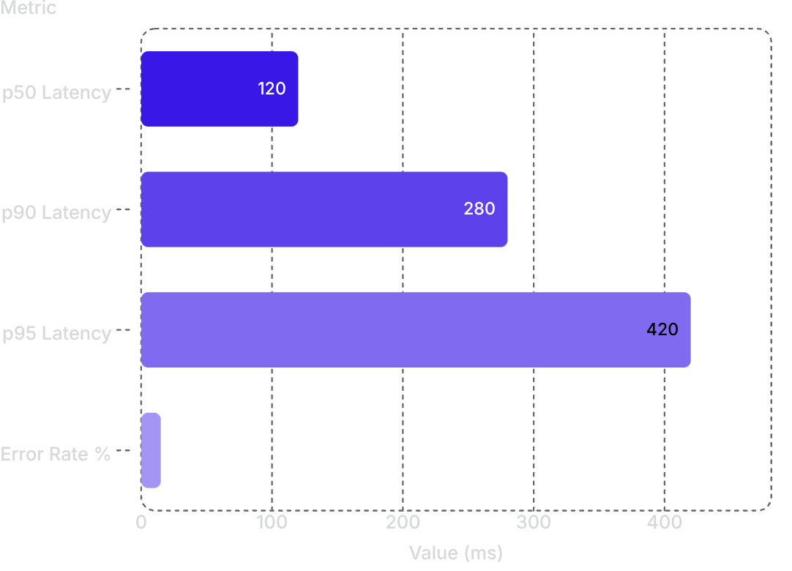

PERFORMANCE DASHBOARD
Performance Testing with k6
2500ms
1800ms
0.1
p95
LCP
FCP
CLS
API Latency
Largest Contentful Paint
First Contentful Paint
Cumulative Layout Shift
Response percentile
Web Vitals Targets
API Load Test Metrics
75%
85%
LCP < 2500ms
FCP < 1800ms
90%
80%
CLS < 0.1
TTFB < 800ms
Pipeline Gate: Builds fail automatically if any Web Vital or API threshold is breached.

Slide 10




Cross-Browser Compatibility & Real-Time Notifications
GDS-compliant rendering validated across all major browsers via BrowserStack cloud — with instant Slack alerts on every test run.
🔔 Real-Time Slack Alerts
Chrome
✅ Test Results
Win 11
Pass/Fail counts, pass rate & failed test names
🔗 Report Links
Allure report & pipeline links with duration
Edge
Win 11
🛡 Security Alerts
ZAP vulnerability counts & k6 Web Vitals summary
Firefox
Win 11
Safari
macOS
BrowserStack Integration
CDP WebSocket
Live cloud cross-browser rendering
Coverage
4 browsers × 2 OS = full GDS matrix

Slide 11










ZERO MANUAL LOGGING
Automated Failure Reporting & Migration from Legacy
When tests fail, the system instantly captures and broadcasts everything your team needs — no human intervention required. Built on a modernised stack migrated from legacy tooling.
🔍 Triggers Automatically When
📋 Every Failure Report Includes
Functional Test Fails
Any failing Cypress or integration test triggers the pipeline
Pipeline Link
Branch & Env
Tags Used
Allure Report Shows Failures
Direct URL to the CI run
Exact context of failure
Test scope of the run
Report generation detects and flags failed scenarios
✅ Zero manual logging — failures reported instantly to Slack.
Failure Count
Allure Report
Slack Alert
Total failed tests
Full visual test report
Instant team notification
🔄 Migration from Legacy
Legacy
Selenium / Java / Cucumber
Manual Postman tests
No CI/CD pipeline
Migrated To
Playwright / TypeScript
Automated API tests
Full GitLab CI/CD

Slide 12
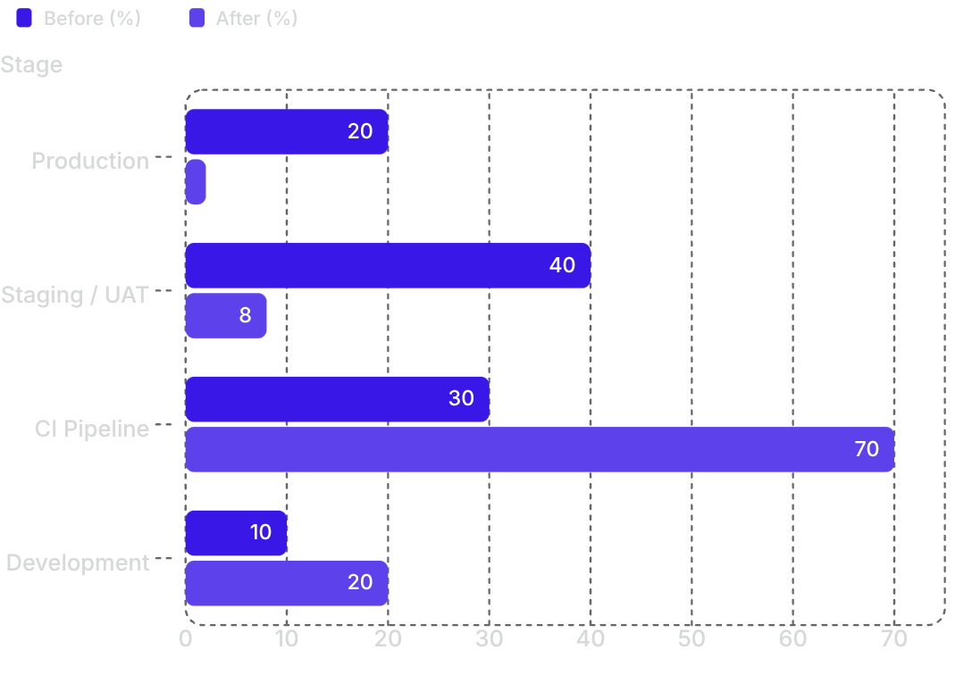
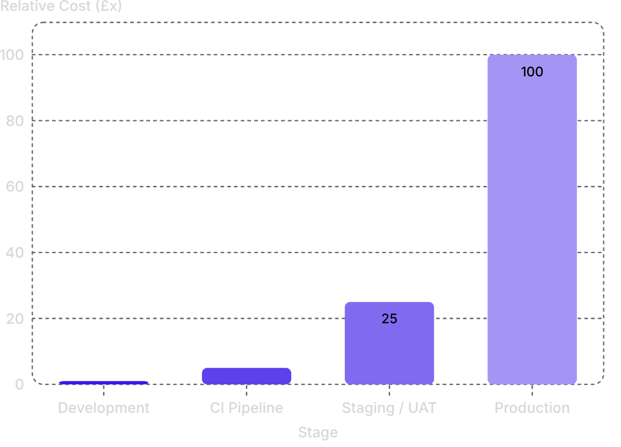

Impact & Key Outcomes
Delivering measurable ROI across all 6 CMS projects through shift-left quality engineering
80%+
90%
Less Manual Testing
Faster Feedback
Reduction in regression effort across all 6 projects
Story-based vs full regression
6
5
CMS Projects
Quality Gates
Covered by automated CI/CD
Functional · Security · Performance · Compatibility · Reporting
🎯 Shift-Left: Defect Detection
💰 Cost of Defect by Stage
Production defects dropped from 20% → 2%
Production bugs cost £100x more than dev-time fixes
Strategic Value: A living quality platform that scales with the programme, enforces GDS standards automatically, and gives every team real-time confidence in every deployment.

Slide 13

Key Differentiators & Impact
Tangible improvements and strategic advantages through enhanced quality engineering.
60%
92%
Test Rationalization
Faster Regression
1000+ legacy → ~400 high-value scenarios
~4 hours → ~20 minutes per cycle
80%+
18x
Automation Coverage
Defect Leakage Cut
Manual effort dramatically reduced
Production defects: 20% → 2%
🛠 Strategic Differentiators
🤖 AI-Assisted Migration
⚡ Parallel Execution
3× faster Selenium → Playwright via GitLab Duo
4 concurrent test runs, improved stability
🔁 CI/CD Integration
🛡 Defect Leakage
<5 min feedback loop on every commit
20% → 2% production defect rate
🔗 E2E Testing
📦 Scalable Frameworks
200+ scenarios across UI, API, Kafka & AWS
6 services covered by reusable automation
✅ Release Confidence
🤝 Stakeholder Alignment
95% pass rate on continuous validation gates
100% alignment across dev, product & business
Overall Business Impact: Quality engineering transformation delivered an estimated 10×+ ROI — combining ~£500K+ in avoided production defect costs, 92% faster regression cycles, and a scalable platform now covering 6 CMS services with 95% release confidence.

Slide 14
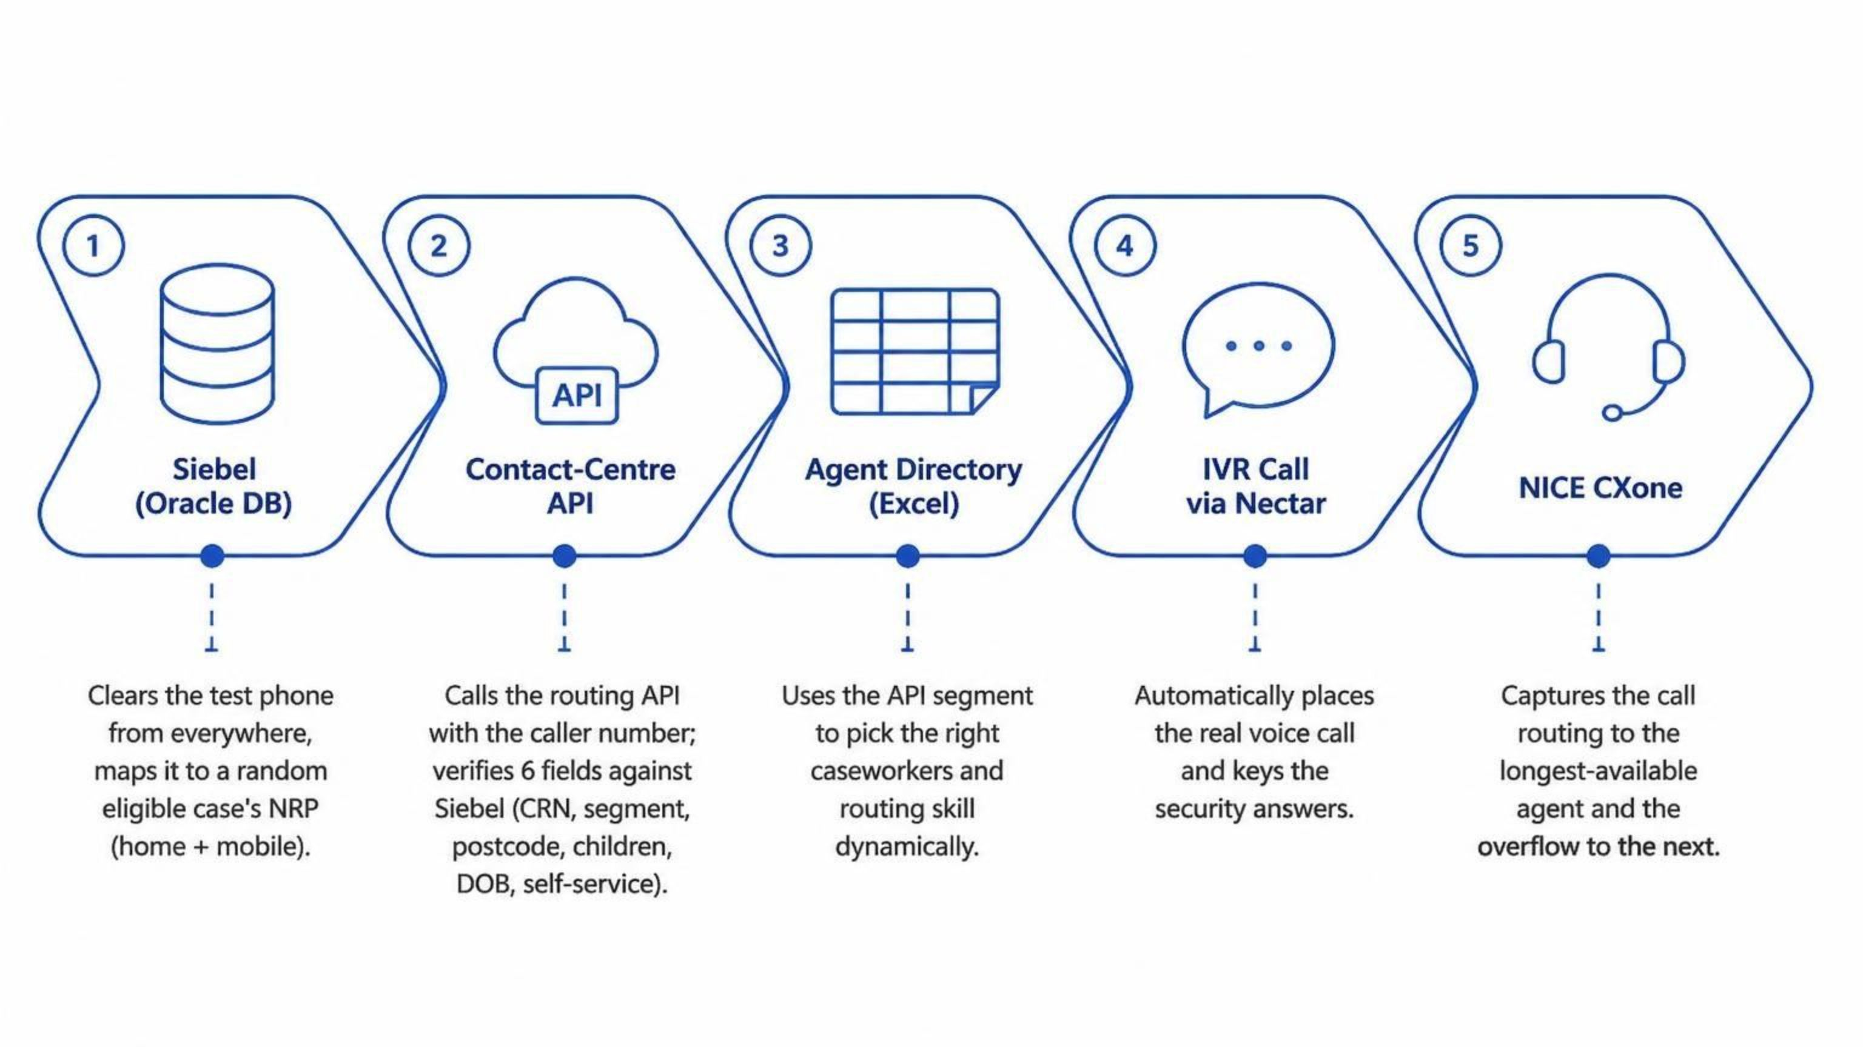
End-to-End Automated Testing: DWP Caseworker Call Flow
One command drives the entire journey — Siebel data setup to live call routing.
Fully automated • Dynamic & configurable • Repeatable in ~3 minutes.

Slide 15
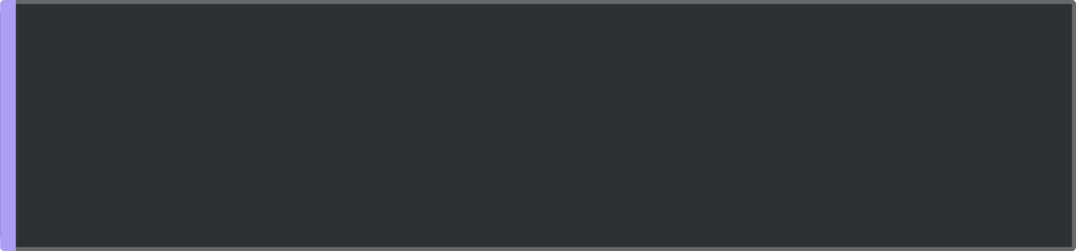

Automated Scenarios & Business Value
Scenarios Automated
Business Value
Replaces slow, error-prone manual testing with a one-command run.
Fully dynamic — any phone, case, segment, or agent via simple config.
Repeatable and demo-ready; proven against the live SIT environment.
Scales across segments without code changes.
End-to-end call routing
call reaches the longest-available caseworker, overflows to the next on no-answer.
Agent-to-agent warm transfer
caseworker answers, then transfers the call to a colleague.
API-to-Siebel data verification
across every routing field.
Built with: Playwright + TypeScript • Oracle (Siebel) • NICE CXone API • Nectar RADAR.

Slide 16
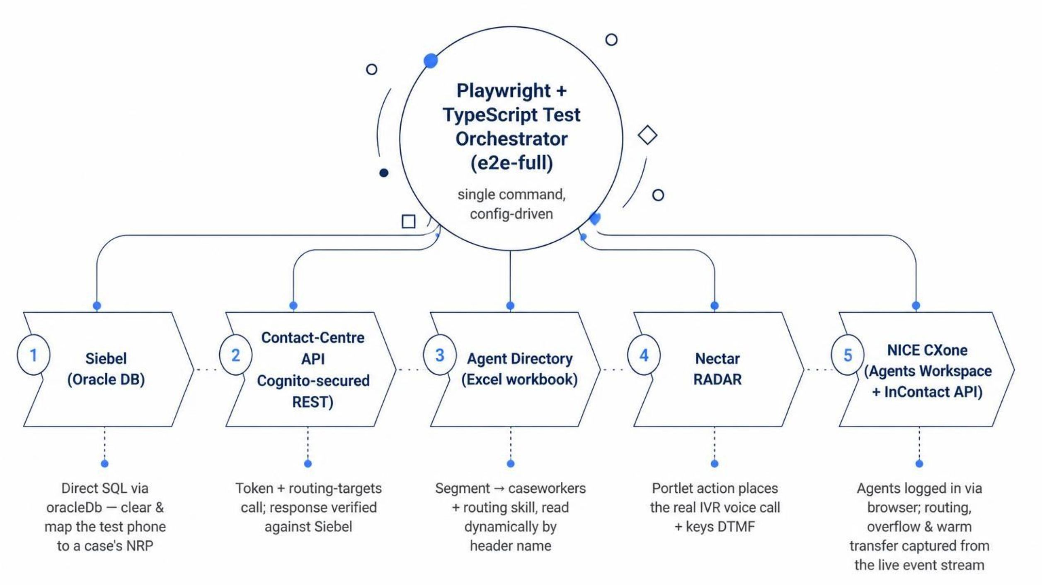
Solution Architecture — Automated Caseworker Call Flow
src/siebelDb.ts • src/contactCentre.ts • src/agentDirectory.ts • src/NectarRunner.ts • src/cxoneClient.ts • src/LiveAgent.ts
Modular • Dynamic • Secrets in .env • No hardcoded data.

